Slide 1

Introduction
to
Computer Science
CS101.3
Lecture #13

Slide 2
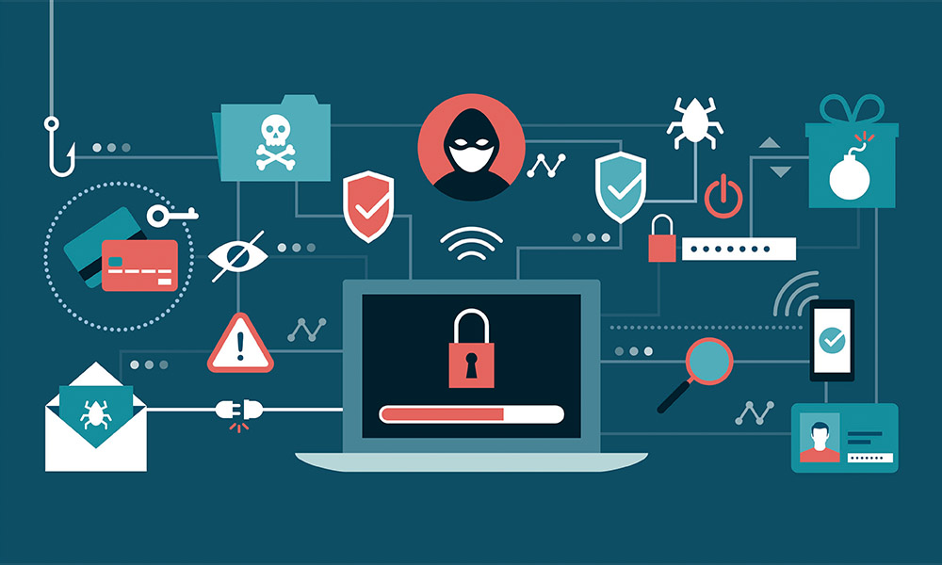
Cyber Security

Slide 3
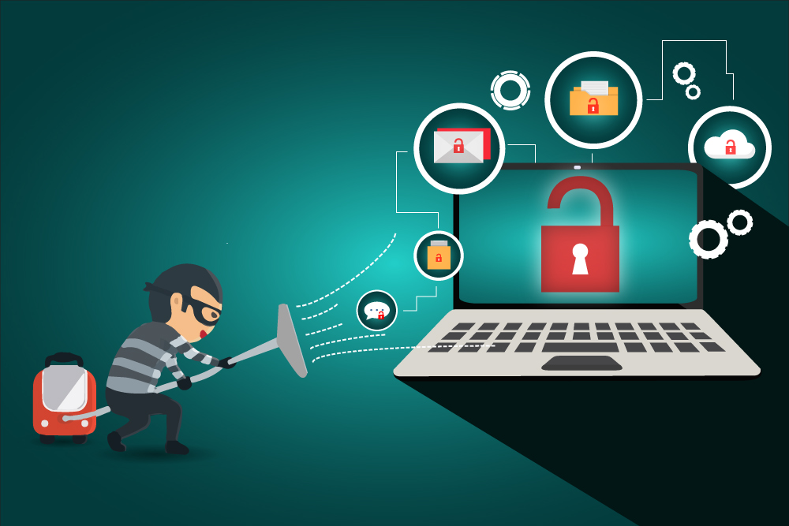
Cyber Security Threats
A Cybersecurity threat is a malicious and deliberate attack by an individual or organization to gain unauthorized access to another individual’s or organization’s network to damage, disrupt, or steal IT assets, computer networks, intellectual property or any other form of sensitive data

Slide 4
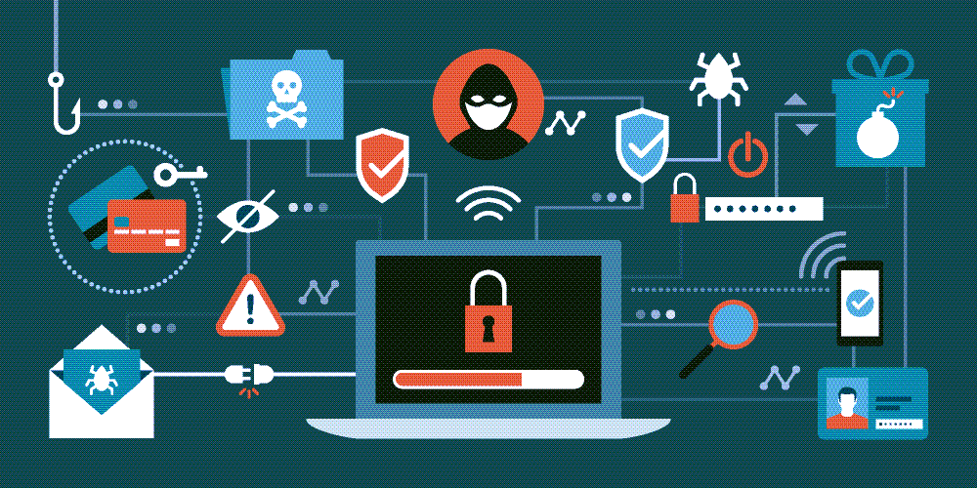
Types of Cyber Security Threats
Malware
Phishing
Spear Phishing
Man in the Middle Attack
Denial of Service Attack
SQL Injection

Slide 5
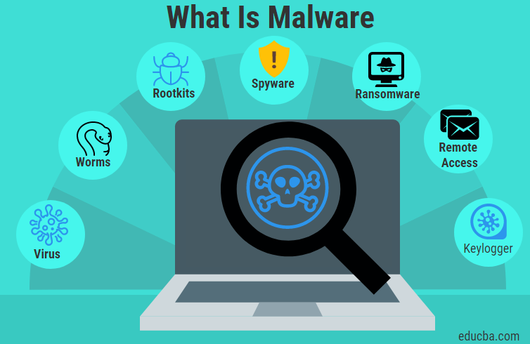
Malware
Malware attacks are the most common type of cyberattack. Malware is defined as malicious software, including spyware, ransomware, viruses, and worms, which gets installed into the system when the user clicks a dangerous link or email. Once inside the system, malware can block access to critical components of the network, damage the system, and gather confidential information, among others.

Slide 6
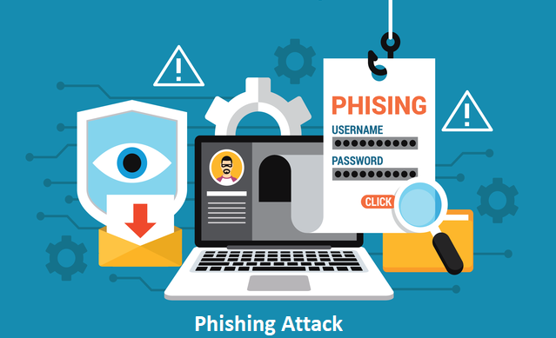
Phishing
Cybercriminals send malicious emails that seem to come from legitimate resources. The user is then tricked into clicking the malicious link in the email, leading to malware installation or disclosure of sensitive information like credit card details and login credentials.

Slide 7
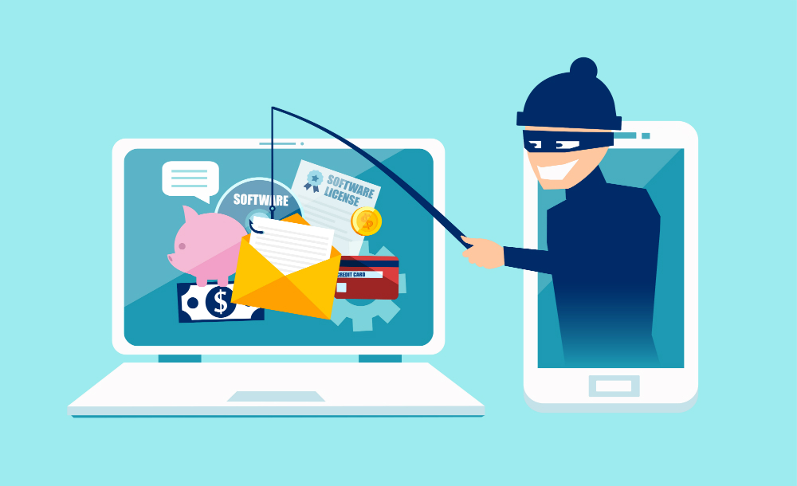
Spear Phishing
Spear phishing is a more sophisticated form of a phishing attack in which cybercriminals target only privileged users such as system administrators and C-suite executives.

Slide 8
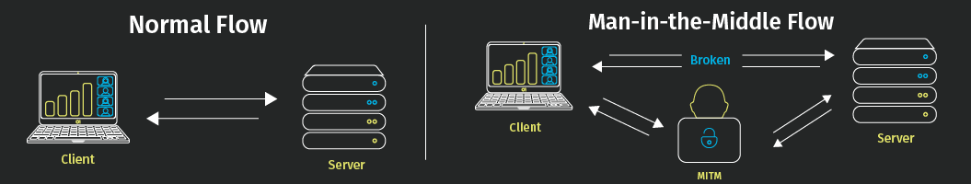
Man in the Middle Attack
Man in the Middle (MitM) attack occurs when cyber criminals place themselves between a two-party communication. Once the attacker interprets the communication, they may filter and steal sensitive data and return different responses to the user.

Slide 9
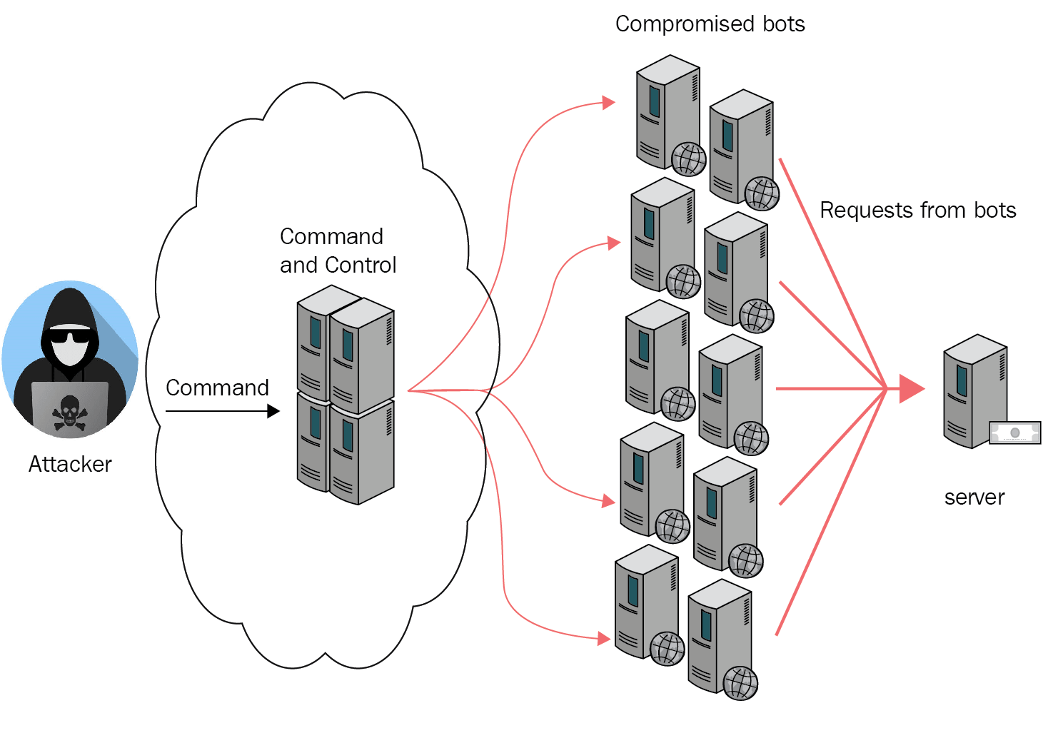
Denial of Service Attack
Denial of Service attacks aims at flooding systems, networks, or servers with massive traffic, thereby making the system unable to fulfill legitimate requests. Attacks can also use several infected devices to launch an attack on the target system. This is known as a Distributed Denial of Service (DDoS) attack.

Slide 10
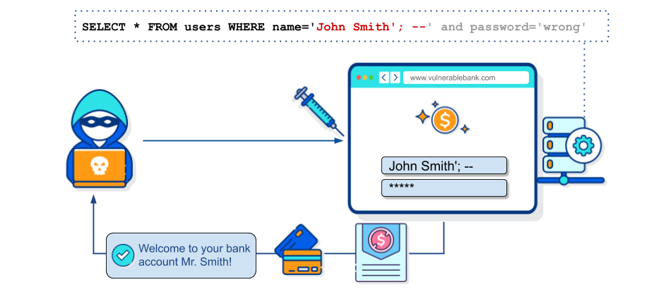
SQL Injection
A Structured Query Language (SQL) injection attack occurs when cybercriminals attempt to access the database by uploading malicious SQL scripts. Once successful, the malicious actor can view, change, or delete data stored in the SQL database.

Slide 11
Sources of Cyber Security Threats
Criminal Groups
Criminal groups aim to infiltrate systems or networks for financial gain. These groups use phishing, spam, spyware, and malware to conduct identity theft, online fraud, and system extortion.
Hackers
Hackers explore various cyber techniques to breach defences and exploit vulnerabilities in a computer system or network. They are motivated by personal gain, revenge, stalking, financial gain, and political activism. Hackers develop new types of threats for the thrill of challenge or bragging rights in the hacker community.

Slide 12
Sources of Cyber Security Threats
Terrorist Groups
Terrorists conduct cyber attacks to destroy, infiltrate, or exploit critical infrastructure to threaten national security, compromise military equipment, disrupt the economy, and cause mass casualties.
Hacktivists
Hacktivists carry out cyberattacks in support of political causes rather than financial gain. They target industries, organizations, or individuals who don’t align with their political ideas and agenda.

Slide 13
Best Practices to Protect From Cyber Threats
Regularly update System and Software
As cyber threats are evolving rapidly, your optimized security network can become outdated within no time, putting your organization at the risk of cyberattack. Therefore, regularly update the security network and the associated systems and software.
Backup Data
Backing up data regularly helps reduce the risk of data breaches. Backup your website, applications, databases, emails, attachments, files, calendars, and more on an ongoing and consistent basis.

Slide 14
Best Practices to Protect From Cyber Threats
Initiate Phishing Simulation
Organizations must conduct phishing simulations to educate employees on how to avoid clicking malicious links or downloading attachments. It helps employees understand the far-reaching effects of a phishing attack on an organization.
Secure site with HTTPS
Organizations must encrypt and secure their website with an SSL (Secure Sockets Layer) certificate. HTTPS protects the integrity and confidentiality of data between the user and the website.

